Slide 1
AWS Step Functions
Deep dive

Slide 2
Agenda
Why orchestration?
What is AWS Step Functions?
Workflow Studio
Workflow types
States
Integrations patterns
State machine data
Workflow patterns
Developer tooling
Observability
Best practices

Slide 3
Why orchestration?

Slide 4

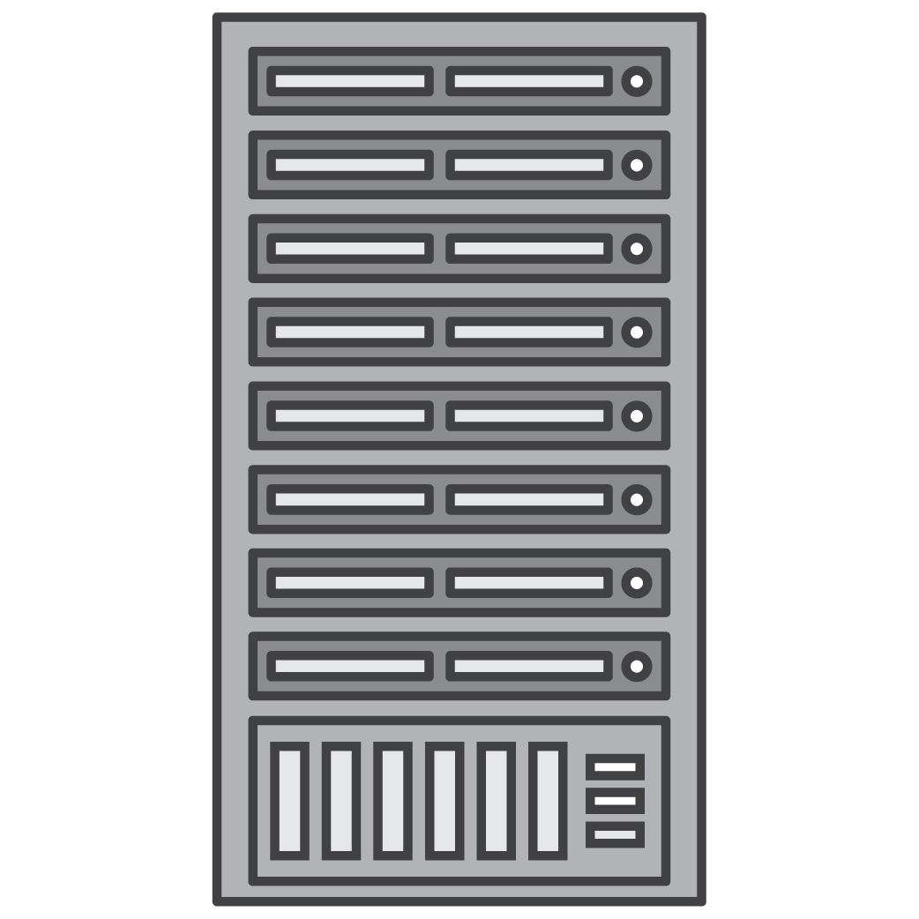


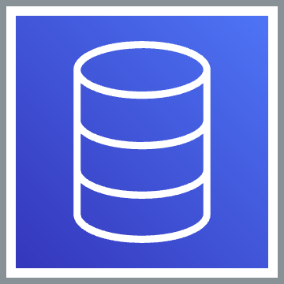
Modern app
Queue
Database
Notes:
Lambdas are stateless, event driven functions that exist in the cloud.
But there aren’t that many apps with only one function, one entry point, one module, one component. So there’ll be more than one function. {NEXT}
In fact, it’ll be common to have LOTS of functions, lots of them talking to each other. {NEXT}
And in fact applications, serverless or not, tend to have databases. {NEXT}
And in the cloud, I notice that a lot of them have queues of one kind or another. {NEXT}
Some of the Lambda functions, connect to servers. {NEXT}
This is more like what an actual modern serverless app might really look like.

Slide 5
Why orchestration?
“I want concurrent and iterative tasks”
“I want try/catch/finally”
“I want to sequence tasks”
“I want to retry failed tasks”
A
B
A
A
B
“I want to select tasks based on data”
C
“I want to run tasks in parallel”
A
A
B
C
B
?
C

Slide 6
Example use case
Suppose I want to book my vacation to the Grand Canyon…
…but unwind my reservations if I can’t rent a car.
Notes:
Let’s think of a scenario when workflows come into play.
I want to book a vacation to the grand canyon. But I want to unwind the reservation if I cannot rent a car, cancelling my flights and my hotels.

Slide 7
Coordination by method call
Notes:
You could just link your functions together, and that’s not a terrible but that does not give you modular, independent, functions that each do one thing well.

Slide 8
Coordination by function chaining
Notes:
If you invoke one Lambda from another, and you do it synchronously, well, that doesn’t scale, because it might want to call another, and another, and so on. So you do it asynchronously, which is actually better design, but then error handling gets hard. Even finding out about errors requires extra assembly.

Slide 9
Coordination by database
Notes:
Also, you could keep track of your state by writing it into a database – for example Amazon DynamoDB or another postrelational database – or you could even use SQL, particularly if you need transactions. People are doing this and they’re getting OK results, but once again, but this is still a lot of work.

Slide 10
Coordination by queues
Notes:
Another approach is to pass your state and control around through queues, or streams. Once again, this involves a lot of book-keeping. If the function that reads the queue gets a failure, you need to catch that and rewrite the state of the world back into the queue, and if you want time-out and retries, you’re going to have to that yourself..

Slide 11
Orchestration and choreography
Orchestration with Step Functions
One system controls the flow between components
Easier to do end-to-end monitoring, timeout, etc.
Centralized business logic
Choreography with EventBridge
Pass messages between bounded context of services
The flow is an emergent property of events being sent
Easier to extend, modify, and build upon the messages being passed
https://serverlessland.com/event-driven-architecture/visuals/choreography-vs-orchestration

Slide 12
Why orchestration?
Isolate tasks in logical components
Centralize the orchestration workflow

Slide 13
What is AWS Step Functions?

Slide 14
What is AWS Step Functions?
A serverless workflow service offered by AWS
Available in almost every AWS region
A workflow built on AWS Step Functions:
is built using a state machine
is composed of steps called states
is written using Amazon States Language or ASL
can be used to orchestrate multiple AWS services

Slide 15




An image processing workflow
Make a thumbnail
Identify features
Store image metadata
Mountains
People
Snow

Slide 16

Build workflows using eight state types
Mountains
People
Snow

Slide 17



Step Functions benefits
Build and update apps quickly
Write less code
Improve resiliency
Notes:
Build and update apps quickly
AWS Step Functions lets you build visual workflows that enable fast translation of business requirements into technical requirements. You can build applications in a matter of minutes, and when needs change, you can swap or reorganize components without customizing any code.
Write less code
AWS Step Functions manages the logic of your application for you, and implements basic primitives such as branching, parallel execution, and timeouts. This removes extra code that may be repeated in your microservices and functions.
Improve resiliency
AWS Step Functions manages state, checkpoints and restarts for you to make sure that your application executes in order and as expected. Built-in try/catch, retry and rollback capabilities deal with errors and exceptions automatically.

Slide 18



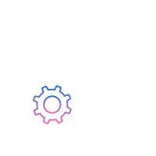
Use Cases for AWS Step Functions
Data processing
IT and security automation
Machine learning
Microservice orchestration

Slide 19
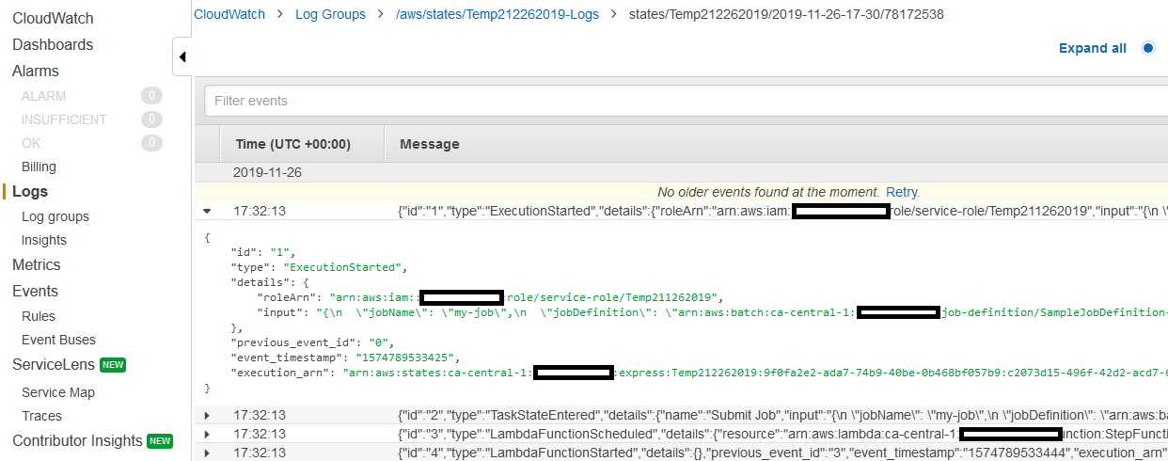
Visual workflows
Define
Visualize
Execute and monitor
Drag-and-drop with Workflow Studio
JSON (Amazon States Language)
CDK (TypeScript, Python, Java, C#, ...)
Data Science SDK (Python)

Slide 20
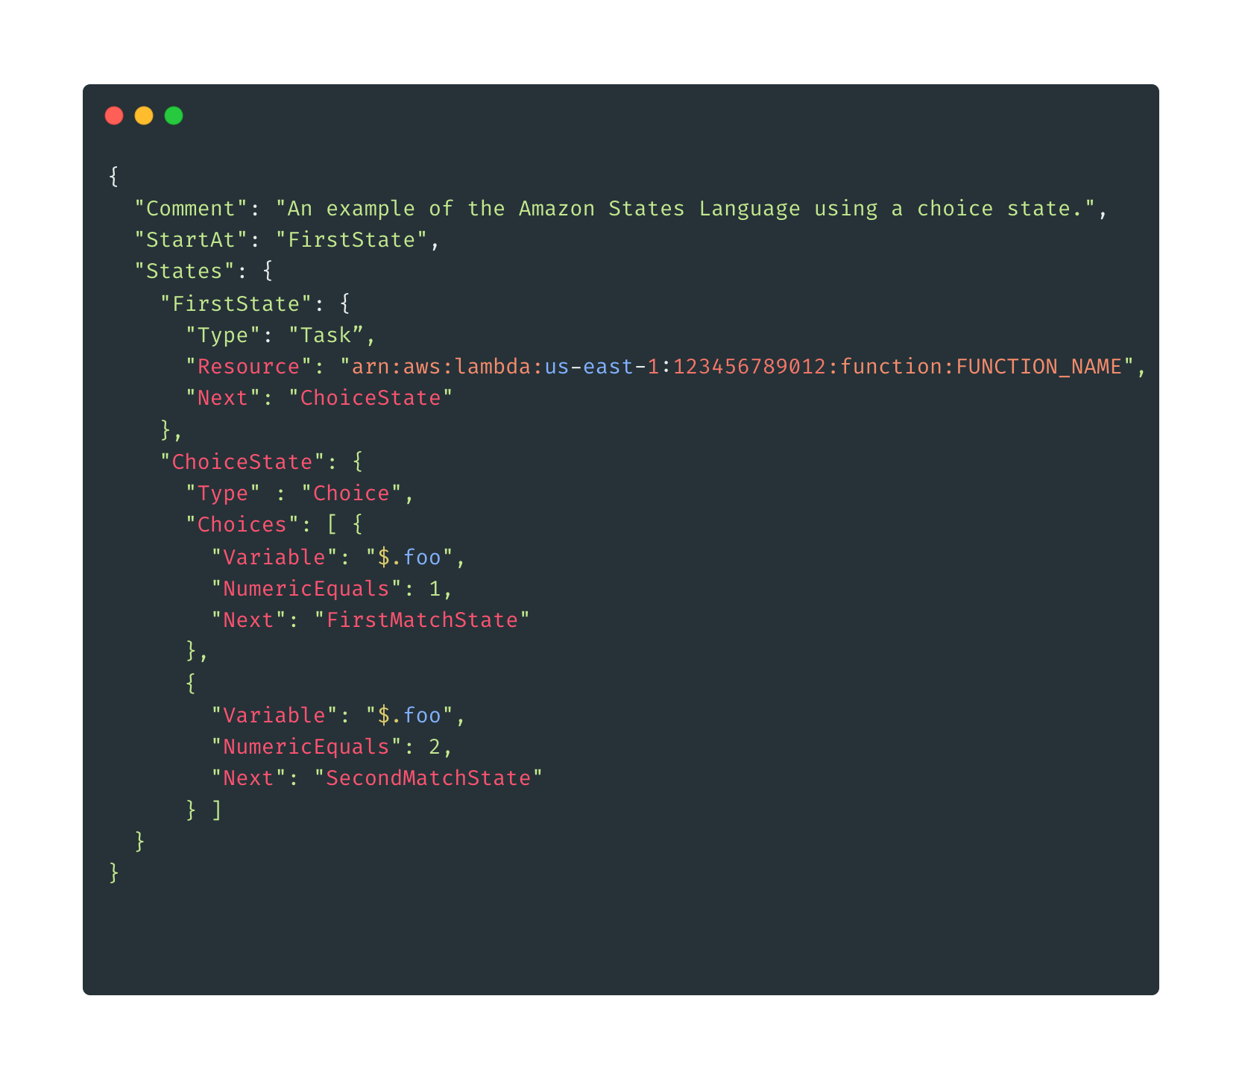
Amazon States Language
https://states-language.net/spec.html

Slide 21
Workflow Studio
Notes:
Now we will explore some application patterns using Step Functions.

Slide 22
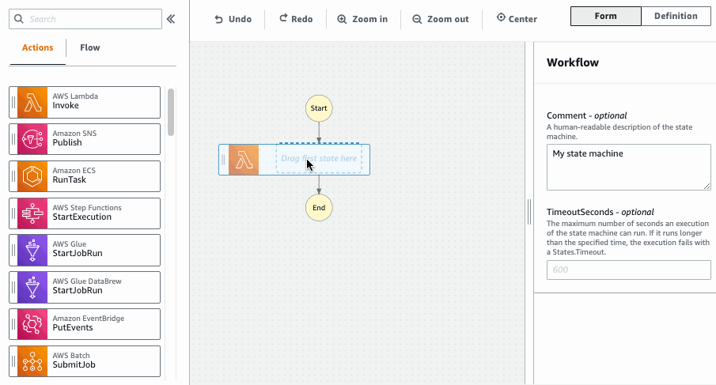
Workflow Studio: Low-code visual designer
Workflow Studio is a drag-and-drop visual builder.
It reduces the time to build a first workflow for new developers.
Experienced developers can use it to build and share prototypes with stackholders faster.
Improved workflow visualization using AWS service icons, automatic workflow layouts, and visual cues from workflow definition.

Slide 23
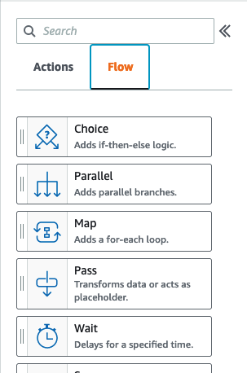
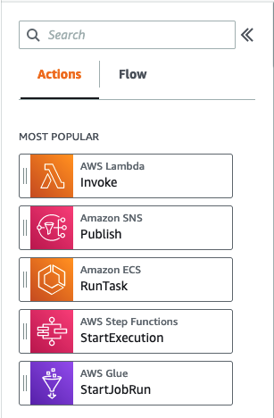
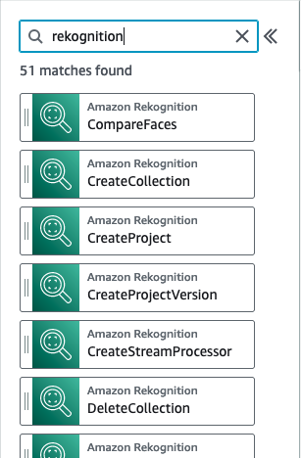
Workflow Studio: Integrations Sidebar
Flow States
Optimized Integrations
AWS SDK Integrations (9000+)

Slide 24
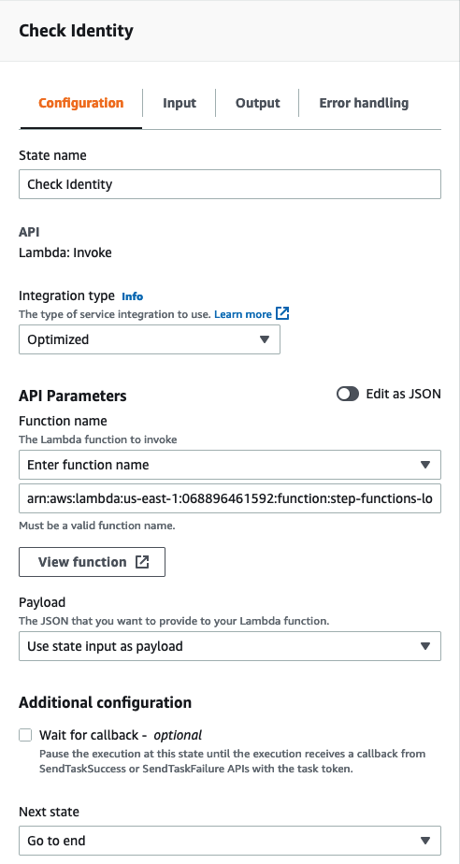
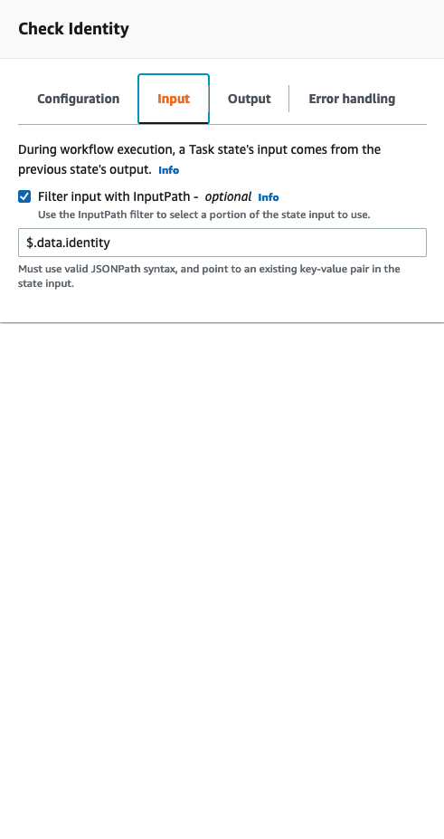
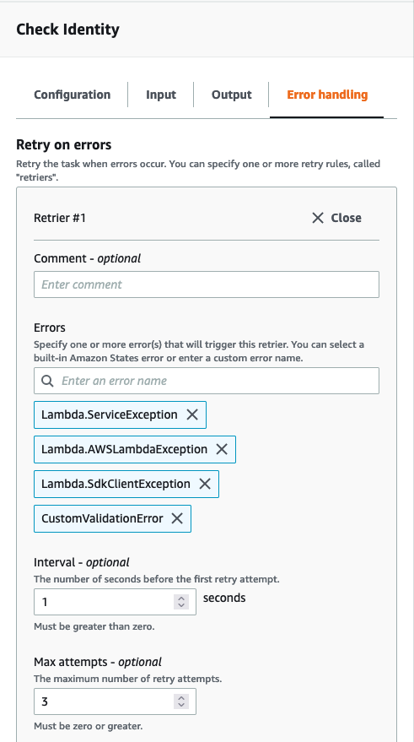
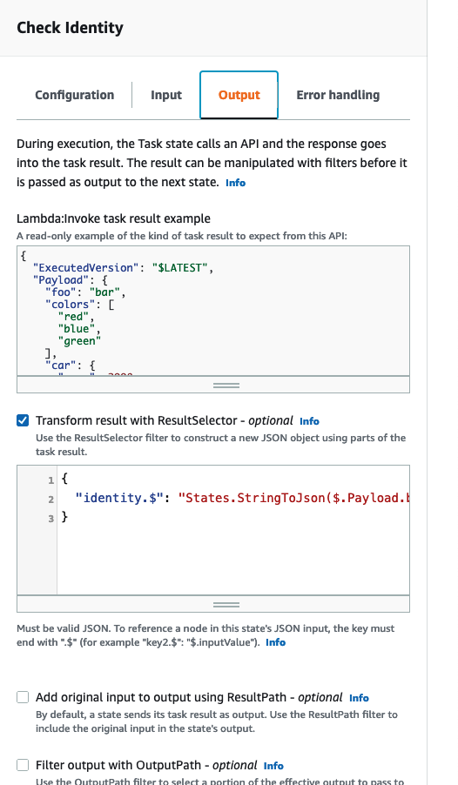
Workflow Studio: Form Configuration
Task Configuration
Input / Output Processing
Error Handling

Slide 25
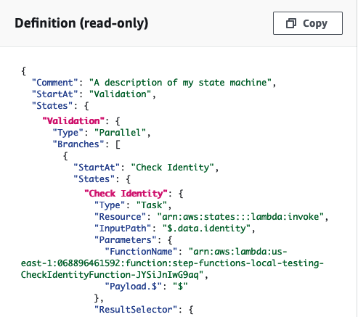
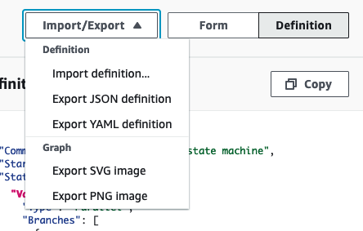
Workflow Studio: ASL and Image Export
Export ASL or Graph image
Amazon States Language (ASL)

Slide 26
Workflow types
Notes:
Now we will explore some application patterns using Step Functions.

Slide 27

Two Workflow Types
STANDARD
EXPRESS WORKFLOWS

Slide 28
Which one is right for my use case?
Flexibility to select the right workflow type for your needs, or integrate them together
Standard Workflows
Express Workflows
IT automation
Report generation
Order processing
Payment and billing processing
ML model training
ETL and big data orchestration (AWS Glue, Amazon EMR)
Media processing (Video, Image, Audio)
Event driven microservices orchestration
High volume data streaming and processing
IoT data ingestion
Order / Cart validation
Payment reconciliation

Slide 29
Execution guarantees
Standard Workflows
Exactly-once workflow execution
Execution state internally persists between state transitions.
Automatically returns an idempotent response on starting an execution
Asynchronous Express Workflows
At-least-once workflow execution
Execution state doesn't persist between state transitions.
Idempotency is not automatically managed.
Synchronous Express Workflows
At-most-once workflow execution
Execution state doesn't persist between state transitions.
Idempotency is not automatically managed.
Notes:
Asynchronous Express Workflows return confirmation that the workflow was started, but don't wait for the workflow to complete. To get the result, you must poll the service's CloudWatch Logs. You can use Asynchronous Express Workflows when you don't require immediate response output, such as messaging services or data processing that other services don't depend on. You can start Asynchronous Express Workflows in response to an event, by a nested workflow in Step Functions, or by using the StartExecution API call.
Synchronous Express Workflows start a workflow, wait until it completes, and then return the result. Synchronous Express Workflows can be used to orchestrate microservices. With Synchronous Express Workflows, you can develop applications without the need to develop additional code to handle errors, retries, or run parallel tasks. You can run Synchronous Express Workflows invoked from Amazon API Gateway, AWS Lambda, or by using the StartSyncExecution API call.

Slide 30
Standard vs. express workflows
 | Standard | Express
Maximum duration | 365 days | 5 minutes
Execution start rate | 1,300 initial bucket size with 300 per second refill rate (in limited regions) | 6000 initial bucket size with 6000 per second refill rate
State transition rate | 5,000 initial bucket with 5,000 per second refill rate (in limited regions) | Unlimited
Executions | Executions are persisted for 90 days in Step Functions, with tooling for visual debugging in the console, and have ARNs. Optionally sent to CloudWatch Logs | Executions logs are only sent to CloudWatch Logs
Payload size | 256 KB | 256 KB
Quotas: https://docs.aws.amazon.com/step-functions/latest/dg/limits-overview.html
Notes:
Another point to call out is that you only get the execution history with tooling for visual debugging in the management console with Standard Workflows. Express Workflows can only send logs to Amazon CloudWatch.
Also, Express workflows are not designed to support use cases that require the execution to pause and resume, like you saw with the Standard Workflow examples earlier in this talk.
When using Express Workflows, make sure your state machine logic is idempotent and should not be affected adversely by multiple concurrent executions of the same input.
Express workflow has to be idempotent

Slide 31
Standard vs. express workflows
 | Standard | Express
Execution semantics | Exactly-once workflow execution | Asynchronous: At-least-once workflow execution Synchronous: At-most-once workflow execution.
Service integrations | Supports all service integrations and activities | Supports all service integrations. Does not support activities.
Integration Patterns | Supports all patterns | Does not support Job-run (.sync) or Callback (.wait For Callback)
Invocation | Asynchronous invocation only | Asynchronous and synchronous invocation
Pricing | $0.025 per 1,000 state transitions | $1.00 per 1M requests + $0.0600 per GB-hour (tiered)
Quotas: https://docs.aws.amazon.com/step-functions/latest/dg/limits-overview.html
Notes:
Another point to call out is that you only get the execution history with tooling for visual debugging in the management console with Standard Workflows. Express Workflows can only send logs to Amazon CloudWatch.
Also, Express workflows are not designed to support use cases that require the execution to pause and resume, like you saw with the Standard Workflow examples earlier in this talk.
When using Express Workflows, make sure your state machine logic is idempotent and should not be affected adversely by multiple concurrent executions of the same input.
Express workflow has to be idempotent

Slide 32

So which one should I use?
Start
?
Which workflow type?
When the workload:
Takes more than 5 minutes
Uses callback (.WaitForTaskToken) or .Sync patterns
Requires exactly-once execution
$.workload.duration > 5 minutes
$.workload.contains(.sync)
$.workload.contains(.WaitForTaskToken)
$.Execution.semantics == Exactly-one
default
Run as Standard
Run as Express
End

Slide 33
States
Notes:
Now we will explore some application patterns using Step Functions.

Slide 34
State Types
Task | Execute work | Map | Process each of an input array's items
Choice | Add branching logic | Pass | Pass input to output
Wait | Add a timed delay | Succeed | Signal a successful execution and stop
Parallel | Execute branches in parallel | Fail | Signal a failed execution and stop
Notes:
Firstly, here is an exhaustive list of all of the state types defined in the Amazon States Language today. You've already seen examples of most of these in this talk. The first one we haven't talked about yet is the Map state type. This state type is very similar to the Map function or concept from functional programming. In programming, you might use a map function to apply a function to each item in an array of values, returning a new array of the same size, with the function results from each application. Similarly, the Map state type allows you to process each of an input array's items with its own state machine, returning an array of results. What's even cooler is that you can configure the maximum degree of parallelism for the Map state to use, which is incredibly useful for doing lots of work at once, or limiting the simultaneous processing if you need to.
Two of the other new state types we haven't talked about yet are the Succeed and Fail states. These are simple states that you can use to semantically signal a successful or failed execution. Each will cause the state machine to stop execution as well.
Finally, the Pass state type is very simple and allows you to just take input and pass it through to output without performing any work. It's very useful when you're first beginning to sketch out a Step Function workflow definition, as you can use these Pass states like placeholders to be replaced by other State types later as you flesh things out.

Slide 35
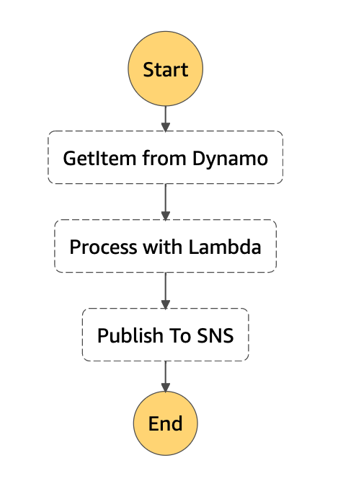
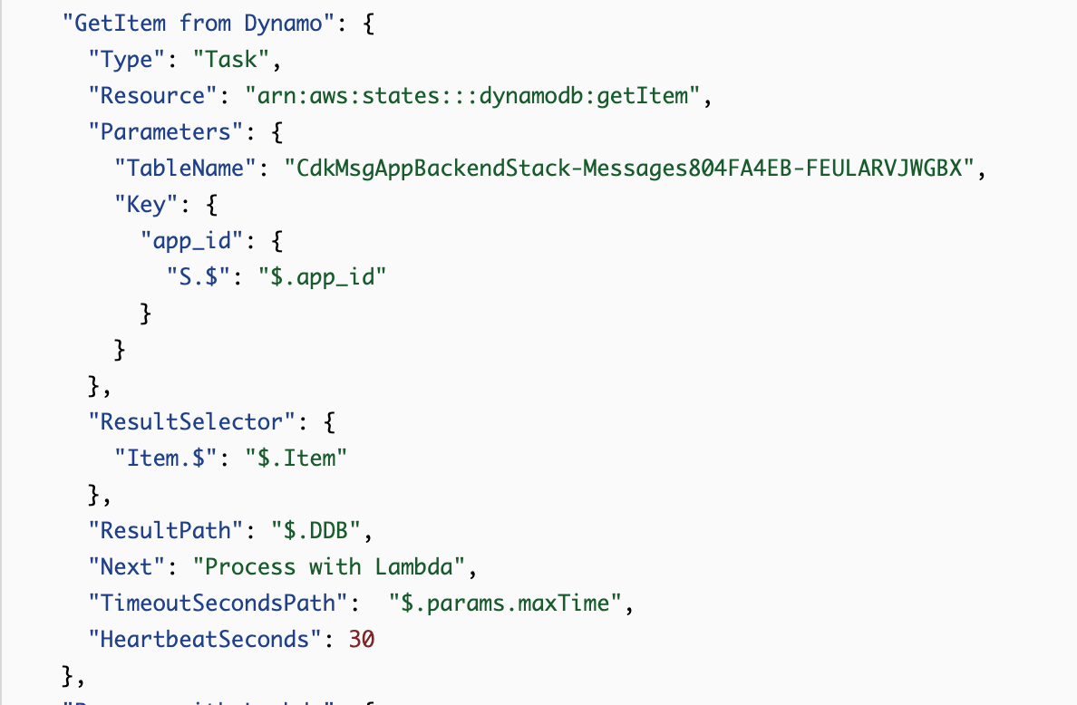
States - Task
A Task state ("Type": "Task") represents a single unit of work performed by a state machine.
Notes:
The Task state performs work. This could be calling an AWS Lambda function, which is a very common use case. But you can also use Task states to wait for a polling worker process, running basically anywhere, to pick work up from a Step Function, perform some computation, and return a result back to the workflow. And, a Task state can also be used to invoke APIs in other AWS services that Step Functions is integrated with.

Slide 36
States – Task Types
Activity
Lambda
Activities represent workers (processes or threads), implemented and hosted by you, that perform a specific task.
Lambda tasks execute a function using AWS Lambda.
AWS Service
HTTP (New)
Step Functions directly calls the API actions of a supported service.
An HTTP Task is a type of Task state that lets you call any public, third-party API, such as Salesforce and Stripe, in your workflows.
Notes:
The Task state performs work. This could be calling an AWS Lambda function, which is a very common use case. But you can also use Task states to wait for a polling worker process, running basically anywhere, to pick work up from a Step Function, perform some computation, and return a result back to the workflow. And, a Task state can also be used to invoke APIs in other AWS services that Step Functions is integrated with.

Slide 37
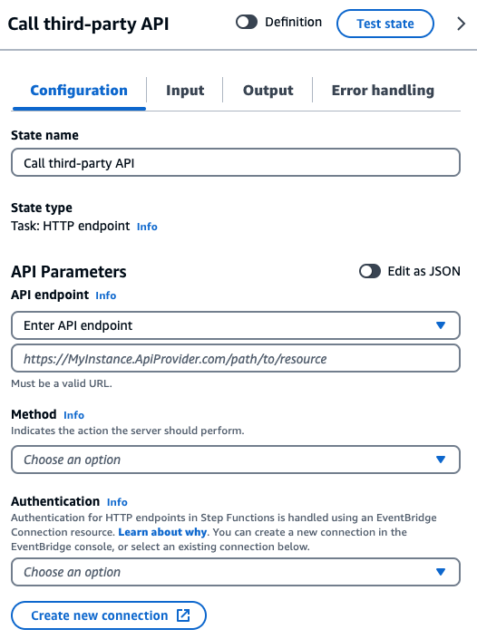
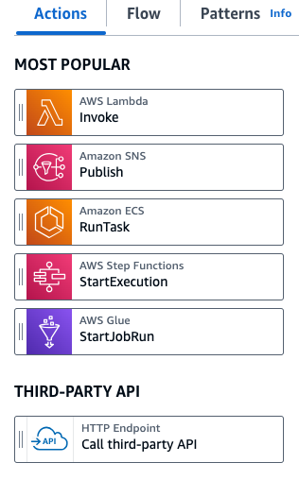
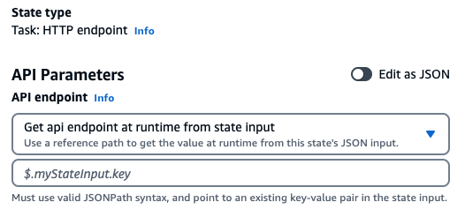
States – Task Types
HTTP (New)
An HTTP Task is a type of Task state that lets you call any public, third-party API, such as Salesforce and Stripe, in your workflows.

Slide 38
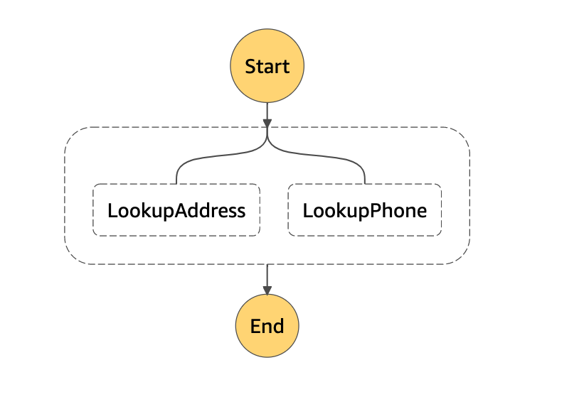
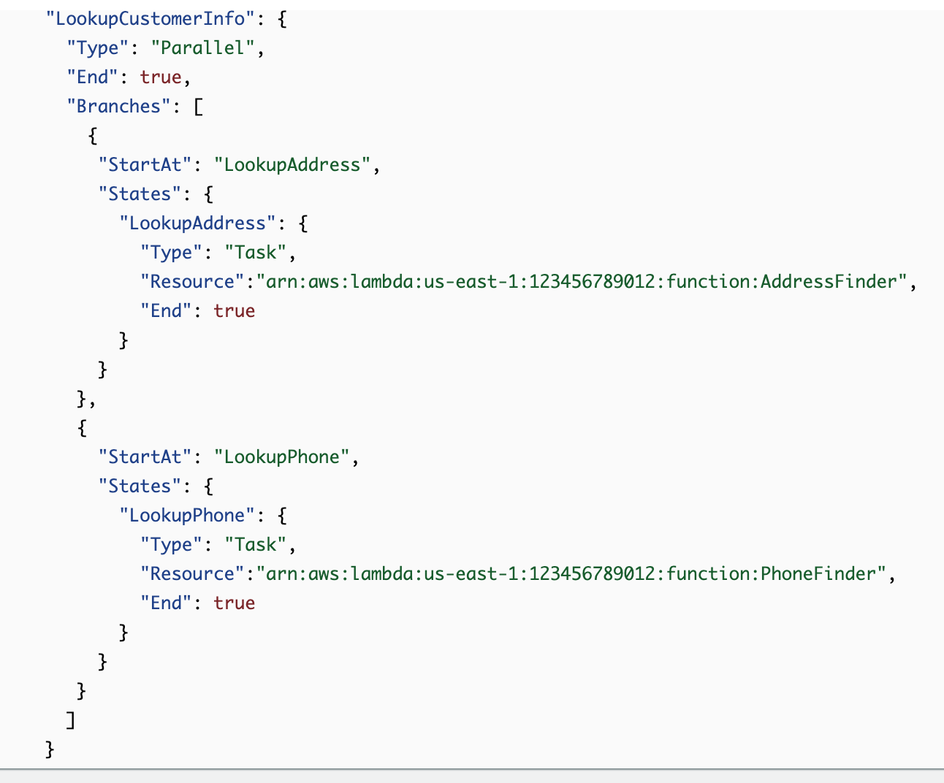
States - Parallel Task
The Parallel state ("Type": "Parallel") can be used to create parallel branches of execution in your state machine.
A Parallel state provides each branch with a copy of its own input data
If any branch fails, the entire Parallel state fails
Upon failure, use a Wait state so that cleanup work happens after the Lambda function has finished
Notes:
The Parallel state ("Type": "Parallel") can be used to create parallel branches of execution in your state machine.
A Parallel state provides each branch with a copy of its own input data (subject to modification by the InputPath field). It generates output that is an array with one element for each branch, containing the output from that branch.
When a parallel state fails, invoked Lambda functions continue to run and activity workers processing a task token are not stopped.

Slide 39
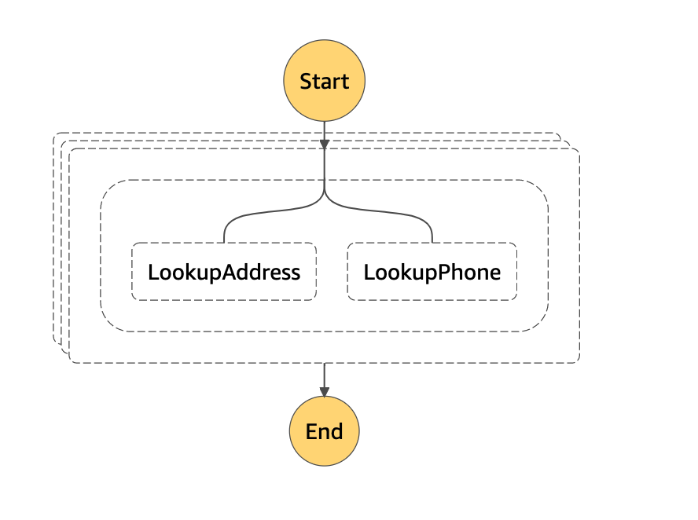
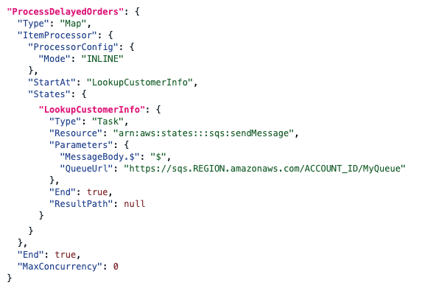
States – Map (Dynamic Parallelism)
The Map state ("Type": "Map") can be used to build dynamically parallel fanout and scatter-gather patterns in minutes
Iterations are invoked as concurrently if MaxConcurrency is 0
The output of the Map state is a JSON array with output from each iteration
If any iteration fails, entire Map state fails, and all iterations are terminated
Notes:
The Map state ("Type": "Map") can be used to run a set of steps for each element of an input array. While the Parallel state executes multiple branches of steps using the same input, a Map state will execute the same steps for multiple entries of an array in the state input.
Concurrent iteratations may be limited. When this occurs, some iterations will not begin until previous iterations have completed. The likelihood of this occurring increases when your input array has more than 40 items.

Slide 40
States – Map modes
Inline
Distributed
In Inline mode, the Map state accepts only a JSON array as input from a previous step in the workflow.
Each iteration of the Map state runs in the context of the workflow that contains the Map state.
In Distributed mode, the Map state can orchestrate large-scale parallel workloads to perform tasks, such as on-demand processing of semi-structured data.
The parallel workloads let you concurrently process large-scale data sources stored in Amazon S3.
You can process a single JSON or CSV file that contains large amounts of data.
You might process a large set of Amazon S3 objects.

Slide 41
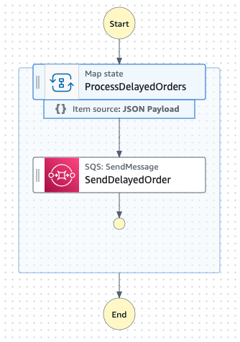
Inline Map - State
Enables dynamic parallelism
Execute the same workflow steps for a collection of items
Achieve parallel processing without the complexity
Map iterations are started within the same execution history which has a 25K limit
Supports up to 40 concurrent iterations
Input and output must be under 256 KB
Notes:
The current map state is being renamed to Inline Map, this enables dynamic parallelism. I pass in a list and the map state runs the same steps for each item in that list.
Map state simplifies the problem of parallel processing for you so there’s no need to handle multi-threading, concurrent operations, and all the complexity that comes with managing this at scale.
This has been a very popular feature and customers have built some powerful systems with it, but it does have some limitations
Map state simplifies the problem of parallel processing for you so there’s no need to handle multi-threading, concurrent operations, and all the complexity that comes with managing this at scale.
Map state allows customers to efficiently process data and they told us they want to do even more.
Some of the challenges they were encountering for large-scale parallel processing was the execution history limit of 25K events, they wanted a larger number of concurrent iterations, and an easy way to process data larger than 256KB.
We improve by observing and listening to customers, so that is exactly what we did.

Slide 42
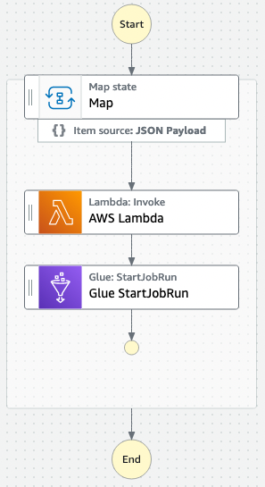



Data Processing
Amazon S3
AWS SDKs
Notes:
You can imagine if you wanted to process thousands of objects that you’d want something that looks like this. And before today there were some ways to build things like this, but it took some work.

Slide 43


Distributed Map - State
Unrivalled parallelism for large scale workloads
Fan-out / Fan-in pattern for high concurrency workloads
Up to 10K concurrency
Iterate over objects in an S3 bucket, process using a workflow
Operator dashboard for tracking progress
Works with Express or Standard Workflows
AWS Step Functions workflow
AWS Step Functions
S3 Bucket
AWS Lambda
Notes:
Introducing Distributed Map, unrivalled parallelism for large scale workloads.
(slide focus)

Slide 44
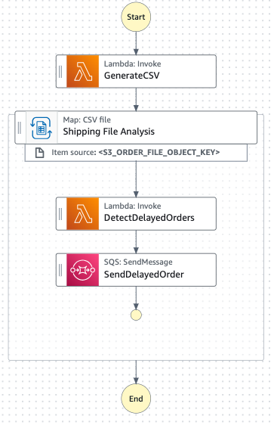
Distributed Map - State
Iterations of the Map state are invoked as individual state machine executions avoiding 25K history event limits for the parent state machine
Iterate over objects, S3 Inventory manifest, or JSON/CSV file in S3, as input and export execution outputs to S3 to bypass input and output limits of 256 KB
Specify MaxConcurrency to control throughput and avoid overwhelming other services
Control your workload with batch sizes and error thresholds, and choose between Standard or Express workflows for your iterations
Notes:
First two bullets on slide

Slide 45
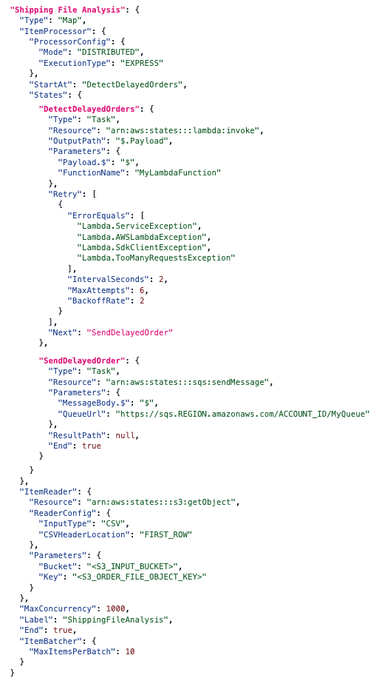
Distributed Map - State
Iterations of the Map state are invoked as individual state machine executions Avoiding 25K history event limits for the parent state machine
Iterate over objects, S3 Inventory manifest, or JSON/CSV file in S3, as input and export execution outputs to S3 to bypass input and output limits of 256 KB
Specify MaxConcurrency to control throughput and avoid overwhelming other services
Control your workload with batch sizes and error thresholds, and choose between Standard or Express workflows for your iterations
Notes:
Last two bullet point on slide
Seed the Standard or Express workflow topics, but leave the full explanation for the corresponding section

Slide 46
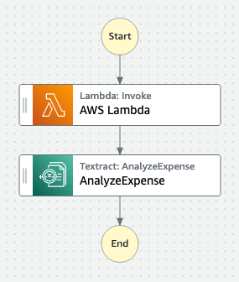
Distributed Map - State
Step Functions Distributed Map
AWS SDKs
AWS SDKs
Amazon S3
AWS SDKs
Amazon S3
AWS SDKs
Step Functions Iterates over and Batches the data for the sub-workflows
Summarized results can be written to S3
Step Functions runs the child workflows to process each item or batch of items, in parallel.
Notes:
Now we’ve made it easy to choose an input source, your Amazon S3 bucket, Step Functions manages each child workflow to process each item from your input source, and then you can choose to write your results back to an Amazon S3 bucket.
We’ve made it easy to choose the type of workflow that you’d like to use to process your data, an Express Workflow or a Standard Workflow, batch the data as you see fit, and support concurrent iterations of up to 10K.
Before we dive deeper, let’s see Distributed Map in action with a demo..

Slide 47
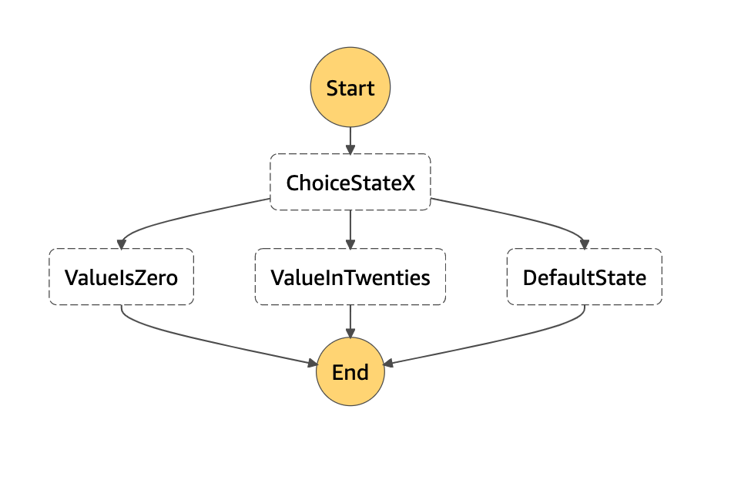
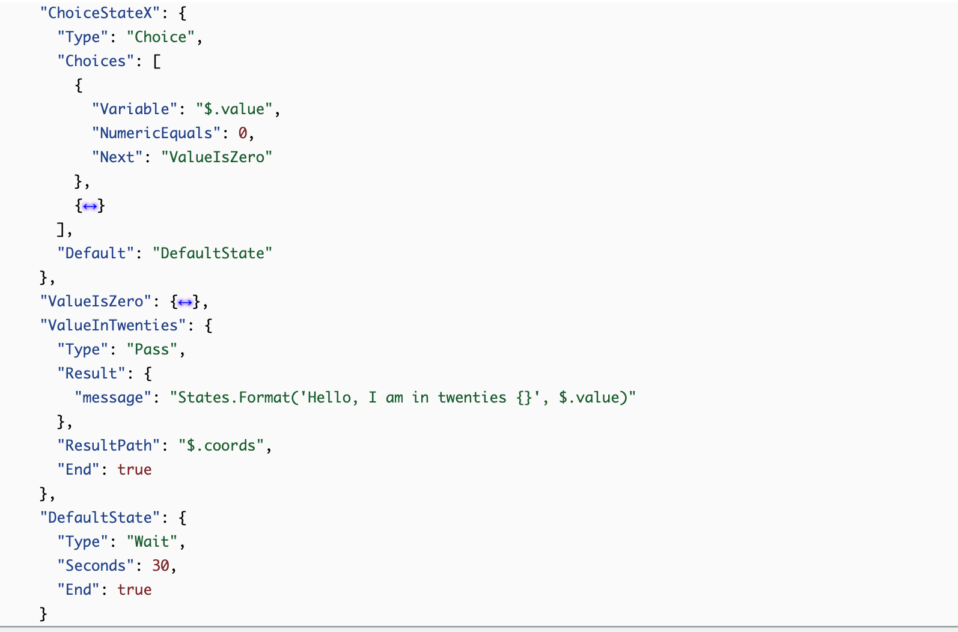
States - Choice, Wait, Pass
A Choice state ("Type": "Choice") adds branching logic to a state machine.
A Wait state ("Type": "Wait") delays the state machine from continuing for a specified time.
A Pass state ("Type": "Pass") passes its input to its output, without performing work.
Notes:
Pass state is useful in debugging as it can add more information into the output send it as input to the next state.

Slide 48
Integration patterns
Notes:
Now we will explore some application patterns using Step Functions.

Slide 49
Task integration patterns
Step Functions will wait for an HTTP response and then progress to the next state. Step Functions will not wait for a job to complete
Request-response
Call a service and have Step Functions wait for a job to complete
Run a Job
Call a service with a task token and have Step Functions wait until that token is returned with a payload
Wait for callback
Notes:
Standard Workflows and Express Workflows support the same set of service integrations but do not support the same integration patterns. Express Workflows do not support Run a Job (.sync) or Wait for Callback (.waitForTaskToken). Express support only statefunction integration with sync
For integrated services such as AWS Batch and Amazon ECS, Step Functions can wait for a request to complete before progressing to the next state. To have Step Functions wait, specify the "Resource" field in your task state definition with the .sync suffix appended after the resource URI.
A task might need to wait for a human approval, integrate with a third party, or call legacy systems. For tasks like these, you can pause Step Functions indefinitely, and wait for an external process or workflow to complete.

Slide 50
















Service integrations – Request Response
AWS Lambda
Amazon SQS
AWS Step Functions
Amazon Athena
Amazon ECS
Request
Amazon SNS
Amazon SageMaker
Amazon API Gateway
AWS Fargate
Amazon DynamoDB
Amazon EMR/EKS
AWS Glue DataBrew
Step Functions invokes the task and pauses until the task responds
AWS Batch
AWS Glue
AWS CodeBuild
Amazon EKS
Amazon
EventBridge
Amazon Bedrock
New
Notes:
You can sue Step Functions for for more than orchestrating Lambda. We support 12 separate service integrations today. Containers, ML, data sicence, messaging and will be adding more over time.
Lambda: Invoke
Bedrock: Invoke
Batch – Submit Job
DDB: Get/Put/Delete/Update Item
ECS/Fargate: RunTask
SNS: Publish
SQS: SendMessage
Glue: StartJobRun
SageMaker: CreateEndPoint, CreateEndpointConfig, UpdateEndpoint CreateHyperParameterTuningJob, CreateLabelingJob, CreateModel, CreateTrainingJob, CreateTransformJob
EMR: createCluster-runJobFlow, setClusterTerminationProtection – setTerminationProtection, terminateCluster – terminateJobFlows, addStep – addJobFlowSteps, cancelStep-cancelSteps, modifyInstanceFleetByName-modifyInstanceFleet, modifyInstanceGroupByName-modifyInstanceGroups,
Code Build: Start/Stop Build, BatchDeleteBuilds, BatchGetReports
SFN: StartExecution
EKS: RunJob, Call, CreateCluster, DeleteCluster, CreateFargateProfile, DeleteFargateProfile, CreateNodeGroup, DeleteNodeGroup
DataBrew: StartJobRun
EventBridge: PutEvents

Slide 51
Service integrations – Run a job (.sync)
Amazon EKS
Amazon Athena
AWS Step Functions
Sync
Amazon ECS
AWS CodeBuild
Amazon SageMaker
AWS Fargate
AWS Glue DataBrew
Amazon EMR/EKS
Step Functions invokes the task and pauses until the task completes
AWS Batch
AWS Glue
Amazon Bedrock
New
Notes:
You can sue Step Functions for for more than orchestrating Lambda. We support 12 separate service integrations today. Containers, ML, data sicence, messaging and will be adding more over time.
Lambda: Invoke
Bedrock: CreateModelCustomizationJob.sync
Batch – Submit Job
DDB: Get/Put/Delete/Update Item
ECS/Fargate: RunTask
SNS: Publish
SQS: SendMessage
Glue: StartJobRun
SageMaker: CreateEndPoint, CreateEndpointConfig, UpdateEndpoint CreateHyperParameterTuningJob, CreateLabelingJob, CreateModel, CreateTrainingJob, CreateTransformJob
EMR: createCluster-runJobFlow, setClusterTerminationProtection – setTerminationProtection, terminateCluster – terminateJobFlows, addStep – addJobFlowSteps, cancelStep-cancelSteps, modifyInstanceFleetByName-modifyInstanceFleet, modifyInstanceGroupByName-modifyInstanceGroups,
Code Build: Start/Stop Build, BatchDeleteBuilds, BatchGetReports
SFN: StartExecution

Slide 52




Service integrations – Wait for Callback (.waitForTaskToken)
Callback Pattern
Call an external resource with a token. Pause workflow for a callback event with the TaskToken.
Wait for as long as you need – minutes, days, weeks, or months:
Human activity
Third party API
Legacy application
AWS Lambda
Amazon SQS
Amazon ECS
Amazon SNS
AWS
Fargate
Amazon
API Gateway
AWS
Step Functions
Amazon
EventBridge
Notes:
Human interactions and long running tasks can be handled using the CallBack pattern. Very helpful, and a lot of customers are not aware of it.
Make a call to a service integration. Passes unique token
Token could be embedded in an email, go to an on-premise legacy server, or to a long running task in a container
Return using the Step Functions API SendTaskSuccess, workflow continues

Slide 53


Activity tasks vs Wait for Callback
Task
Worker
Task
Worker
Review, Approve, Execute
GetActivityTask
Amazon EC2
AWS Lambda
Human
Heartbeat
SendTaskSuccess
Amazon SQS
Legacy or 3rd party App
On-premise Servers
SendTaskSuccess
Worker requests tasks from Step Functions
Step Function pushes tasks. You can implement Heartbeat. Workers are usually external systems.
Notes:
Note who initiates the job in each case.
Activities polls tasks from Step Functions
Wait for Callback pattern pushes task to any of the compatible services which can then integrate with Legacy or 3rd party Systems, or tasks that needs Human Approval.
In both case, a TaskToken is used to identify the task, flag it as complete and resume the workflow
Heartbeats can be implemented in both cases

Slide 54
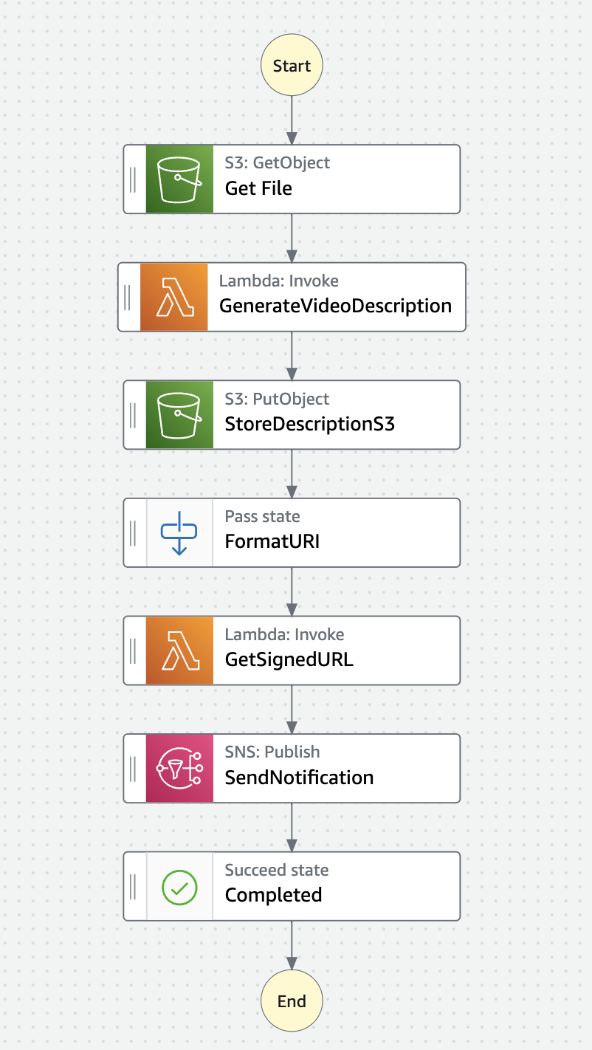
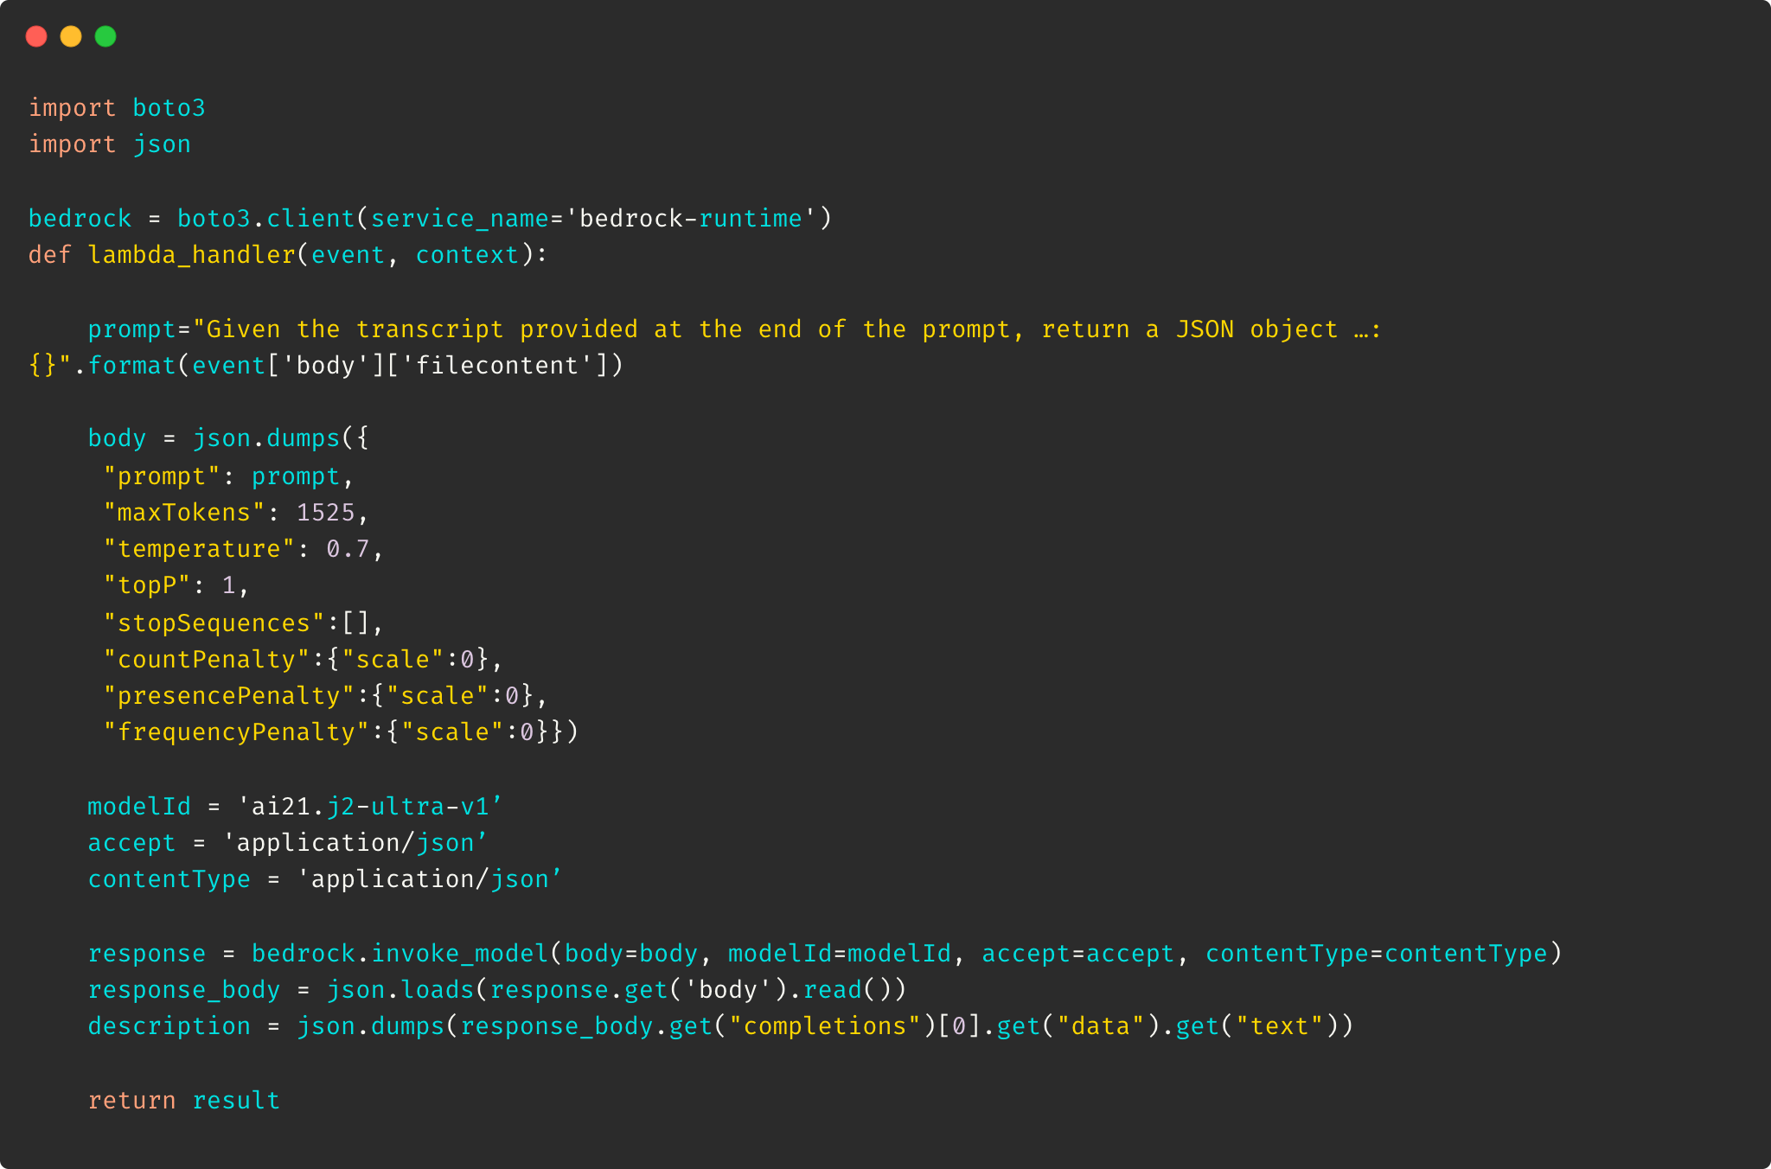
GenAI Use Case
Generating Video description, title, tags (Before re:Invent 2023)
Notes:
This slide → Until re:Invent 2023, you could generate video description, title and tags from the transcription of a video (likely done through Amazon Transcribe). For that, you’d invoke a Lambda function that calls the Bedrock InvokeModel API and returns the result
Next Slide → Since re:Invent 2023, you can directly call the InvokeModel API from a State in Step Function. This removes the need of managing and maintaining another Lambda function with its code, role, logs, etc.

Slide 55
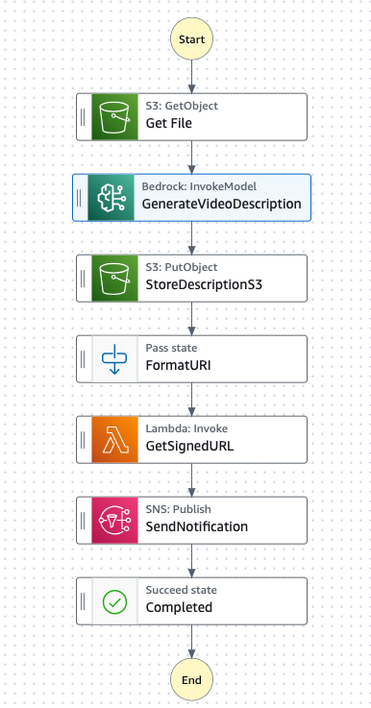
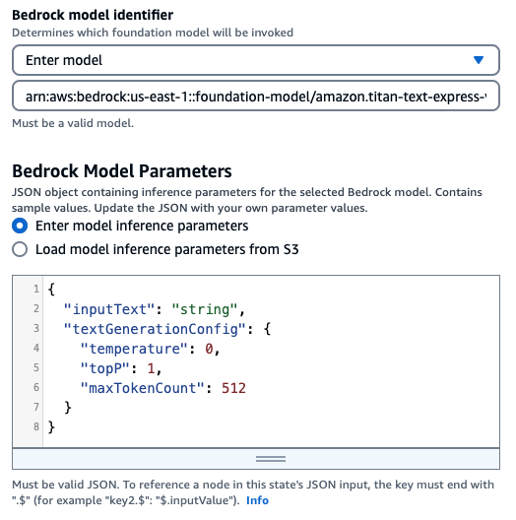
GenAI Use Case
Generating Video description, title, tags (After re:Invent 2023)
Notes:
Previous slide → Until re:Invent 2023, you could generate video description, title and tags from the transcription of a video (likely done through Amazon Transcribe). For that, you’d invoke a Lambda function that calls the Bedrock InvokeModel API and returns the result
This Slide → Since re:Invent 2023, you can directly call the InvokeModel API from a State in Step Function. This removes the need of managing and maintaining another Lambda function with its code, role, logs, etc.

Slide 56
State machine data
Input and Output Processing
Notes:
Now we will explore some application patterns using Step Functions.

Slide 57
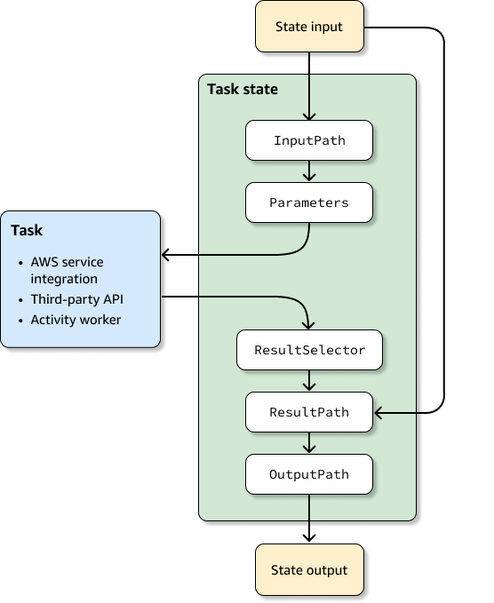
Anatomy of a State
Individual states receive JSON as input and usually pass JSON as output to the next state. Understanding how this information flows from state to state, and learning how to filter and manipulate this data, is key to effectively designing and implementing workflows in AWS Step Functions.
Notes:
Each can use paths to select portions of the JSON from the input or the result.
A path is a string, beginning with $, that identifies nodes within JSON text.
Step Functions paths use JsonPath syntax.
InputPath - select a portion of the state input.
* The Parameters fields allows you to create a collection of key-value pairs that are passed as input to an AWS service integration , such as a Lambda function invocation, or an Activity worker . The values can be static, or they can be selected from the filtered input using a JSONPath expression (for ex. $.myStateInput.value). For key-value pairs where the value is selected with a JSONPath expression, the key name must end in “.$” .
* ResultSelector – construct a new JSON object using parts of the task result
ResultPath - add the result into the original state input. The specified path indicates where to add the result. If ResultPath is unspecified or $, the result becomes the output and the state input is discarded. If ResultPath is a JSONPath expression, the result will be inserted into the state input.
OutputPath - filter the final result before it becomes the state output.
AWS Step Functions applies the InputPath field first, and then the Parameters field. You can first filter your raw input to a selection you want using InputPath, and then apply Parameters to manipulate that input further, or add new values. You can then use the ResultSelector field to manipulate the state's output before ResultPath is applied.
OutputPath enables you to select a portion of the state output to pass to the next state. This enables you to filter out unwanted information, and pass only the portion of JSON that you care about.
If you don't specify an OutputPath the default value is $.

Slide 58
InputPath
Use the InputPath filter to select a portion of the JSON state input to use. Specify which part of the JSON to use with a JSONPath expression.
If not provided, state gets raw input, as-is.
If null, state gets an empty JSON {}.
{
"title": "Numbers to add",
"numbers": [ 3, 4 ]
}
"InputPath": "$.numbers"
[ 3, 4 ]

Slide 59
Parameters
The Parameters fields allows you to create a collection of key-value pairs that are passed as input to an AWS service integration
The values can be static or they can be selected from the filtered input using a JSONPath expression. When the value is selected with a JSONPath expression, the key name must end in “.$”.
{
"title": "Numbers to add",
"numbers": [ 3, 4 ]
}
"Parameters": {
"staticValue": "Just a string",
"SecondNumber.$": "$.numbers[1]"
}
{
"staticValue": "Just a string",
"SecondNumber": 4
}
Notes:
Context Object is also accessible here

Slide 60
ResultSelector
Use the ResultSelector filter to construct a new JSON object using parts of the state result. Normally use for filtering out the metadata of the state result.
The values can be static, or they can be selected from the state result using a JSONPath expression. When the value is selected with a JSONPath expression, the key name must end in “.$”.
{
"title": "Numbers to add",
"numbers": [ 3, 4 ]
}
”ResultSelector": {
"staticValue": "Just a string",
"SecondNumber.$": "$.numbers[1]"
}
{
"staticValue": "Just a string",
"SecondNumber": 4
}
Notes:
For example, Step Functions service integrations return metadata in addition to the payload in the result. ResultSelector can select portions of the result

Slide 61
ResultPath
Use ResultPath to add the result into the original state input. The specified path indicates where to add the result.
If unspecified or $, the result becomes the output and the input is discarded.
If null, state’s input becomes state’s output and task’s output is discarded
If a JSONPath expression, the result will be inserted into the state input.
{
"title": "Numbers to add",
"numbers": [ 3, 4 ]
}
{
"title": "Numbers to add",
"numbers": [ 3, 4 ],
“sum”: 7
}
{
“sum”: 7
}
”ResultPath": $.sum
Notes:
ResultPath can be use for:
Replace Input with Result
Discard Result and Keep Input
Include Result with Input
Update a Node in Input with a Result
Include Error and Input in a Catch

Slide 62
OutputPath
The OutputPath filter allows you to filter the final result before it becomes the state output.
{
"title": "Numbers to add",
"numbers": [ 3, 4 ],
“sum”: 7
}
”OutputPath": $.sum
7

Slide 63
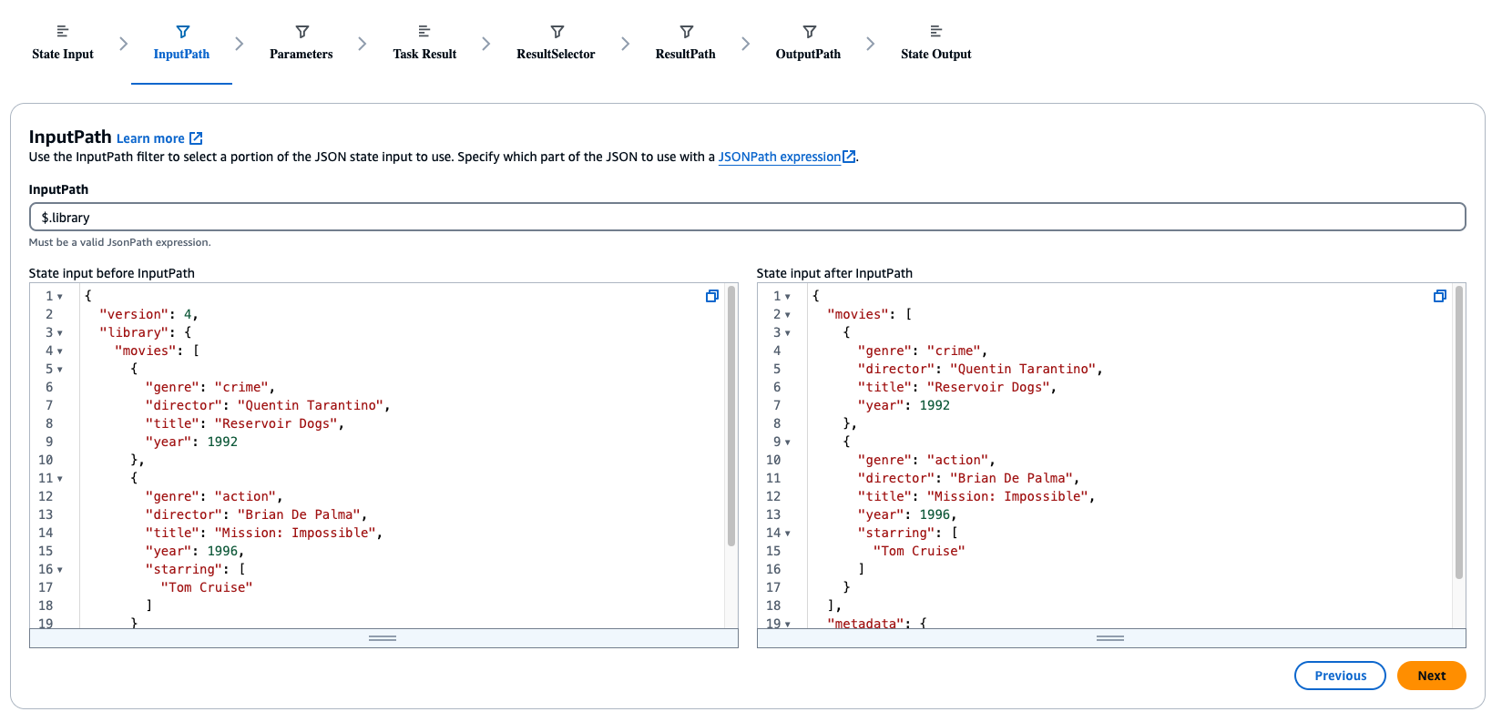
Data flow simulator
Notes:
Use Data Flow simulator to try out your Input/Output filtering expressions

Slide 64
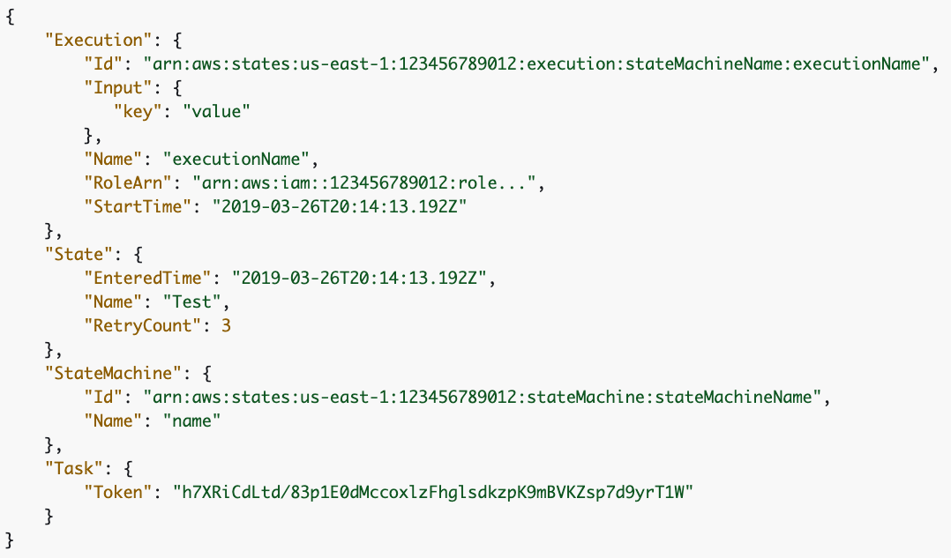
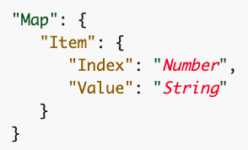
Context Object
An internal JSON structure that is available during an execution
$$.Execution.Id
Notes:
The context object is an internal JSON structure that is available during an execution, and contains information about your state machine and execution. This allows your workflows access to information about their specific execution.
Can be accessed from:
InputPath
OutputPath
ItemsPath (in Map states)
Variable (in Choice states)
ResultSelector
Variable to variable comparison operators

Slide 65
Intrinsic functions
{
”Name": ”Alice",
“JSONString”: "{\"foo\": \"bar\"}”,
“JSON”: { “Key”: “Value”},
“Array”: 12345
}
States.Format('Hello, my name is {}.', $.Name)
Hello, my name is Alice
States.StringToJson($.JSONString)
{ "foo": "bar" }
States.JsonToString($.JSON)
{\”Key\": \”Value\"}
"BuildId.$": "States.Array($.Id)"
“BuildId”: [123456]
Notes:
Intrinsics are constructs that look like functions in programming languages and can be used to help Payload Builders process the data going to and from Task Resources.
Supported fields – Parameters, Result selector in Task and parameters in Pass state
Intrinsic for unique identifier generation -- States.UUID()
Intrinsics for Math operations -- States.MathRandom, States.MathAdd
Intrinsic for hash calculation -- States.Hash
Intrinsic for String operation -- States.StringSplit

Slide 66
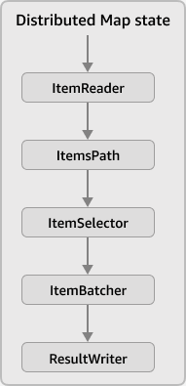
Input and Output in Map state
Map states concurrently iterate over a collection of items in a dataset, such as a JSON array, a list of Amazon S3 objects, or the rows of a CSV file in an Amazon S3 bucket. It repeats a set of steps for each item in the collection.
You can configure the input that the Map state receives and the output it generates using these fields.
Step Functions applies each field in your Distributed Map state in the order shown

Slide 67
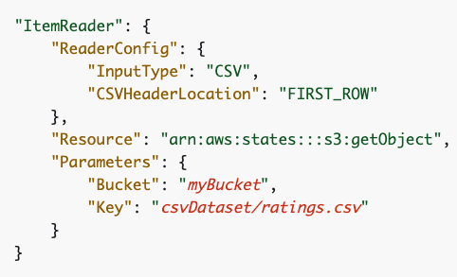
ItemReader
The ItemReader field is a JSON object, which specifies a dataset and its location. A Distributed Map state uses this dataset as its input. The following example shows the syntax of the ItemReader field if your dataset is a CSV file that's stored in an Amazon S3 bucket.
[ “Hello”, “World”]

Slide 68
ItemsPath
The ItemsPath field is used in a Map state to select an array in the input. Specify which part of the JSON to use with a JSONPath expression.
If not provided, state gets entire JSON.
You can use ItemsPath in the Distributed Map state only if you use a JSON input passed from a previous state in the workflow.
{
”words": [ “Hello”, “World”]
"numbers": [ 3, 4 ]
}
"ItemsPath": "$.words"
[ “Hello”, “World”]

Slide 69
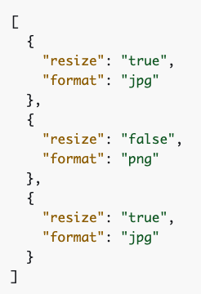
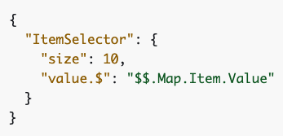
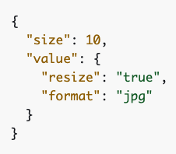
ItemSelector
The ItemSelector field lets you override the data items’ values before they’re passed on to the Map state. To override the values, specify a valid JSON input that contains a collection of key-value pairs. These pairs can be static values provided in your state machine definition, values selected from the state input using a path, or values accessed from the context object.
The ItemSelector field replaces the Parameters field within the Map state.
[ “Hello”, “World”]

Slide 70
ItemBatcher
The ItemBatcher field is a JSON object, which specifies to process a group of items in a single child workflow execution. Use batching when processing large CSV files or JSON arrays, or large sets of Amazon S3 objects.
MaxItemsPerBatch or MaxItemsPerBatchPath → Specifies the maximum number of items that each child workflow execution processes.
MaxInputBytesPerBatch or MaxInputBytesPerBatchPath → Specifies the maximum size of a batch in bytes, up to 256 KBs.
BatchInput → Step Functions merges this input with the input for each individual child workflow executions.
[ “Hello”, “World”]

Slide 71
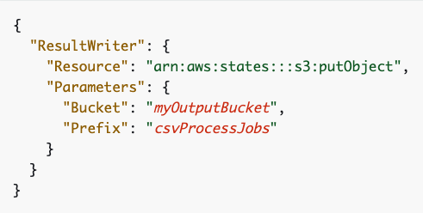
ResultWriter
The ResultWriter field is a JSON object that specifies the Amazon S3 location where Step Functions writes the results of the child workflow executions started by a Distributed Map state. By default, Step Functions doesn't export these results.
Requires IAM permissions
Same AWS Account and Region
[ “Hello”, “World”]

Slide 72
Workflow Patterns
Notes:
Now we will explore some application patterns using Step Functions.

Slide 73
Nested “child” workflows
Easily build complex workflows with libraries of state machines
Swap and reorganize workflow modules without customizing code
Simplifies development and deployment
RunJobPoller
Notes:
One pattern that can be effective is to use Step Functions nesting. You can break down large state machines or you can have re-usable libraries of code. One effective pattern is to combine MAP and nesting. Trigger a workflow while iterating over an array.

Slide 74

Saga Pattern
Roll-back work done by sequence of distributed transactions
Use inherent error handling to roll back sequential system failures for long-running transactions
Notes:
Patterns such as Saga can be created, which represents a series of distributed transactions. The pattern ensures that if something goes wrong in the sequence distributed transactions, the work done by the prior transactions can be rolled back (IE, undoing a flight reservation if hotels are not available).

Slide 75

Circuit Breaker
Start
Get circuit status
Prevent a caller service from retrying another callee service call that has previously caused repeated timeouts or failures
?
Is circuit closed?
{“CircuitStatus”:“CLOSED”}
$.CircuitStatus==“OPEN”
Run Lambda
Catch
Update circuit status
X
Circuit open
Circuit closed
End

Slide 76
Developer Tooling
Notes:
Now we will explore some application patterns using Step Functions.

Slide 77
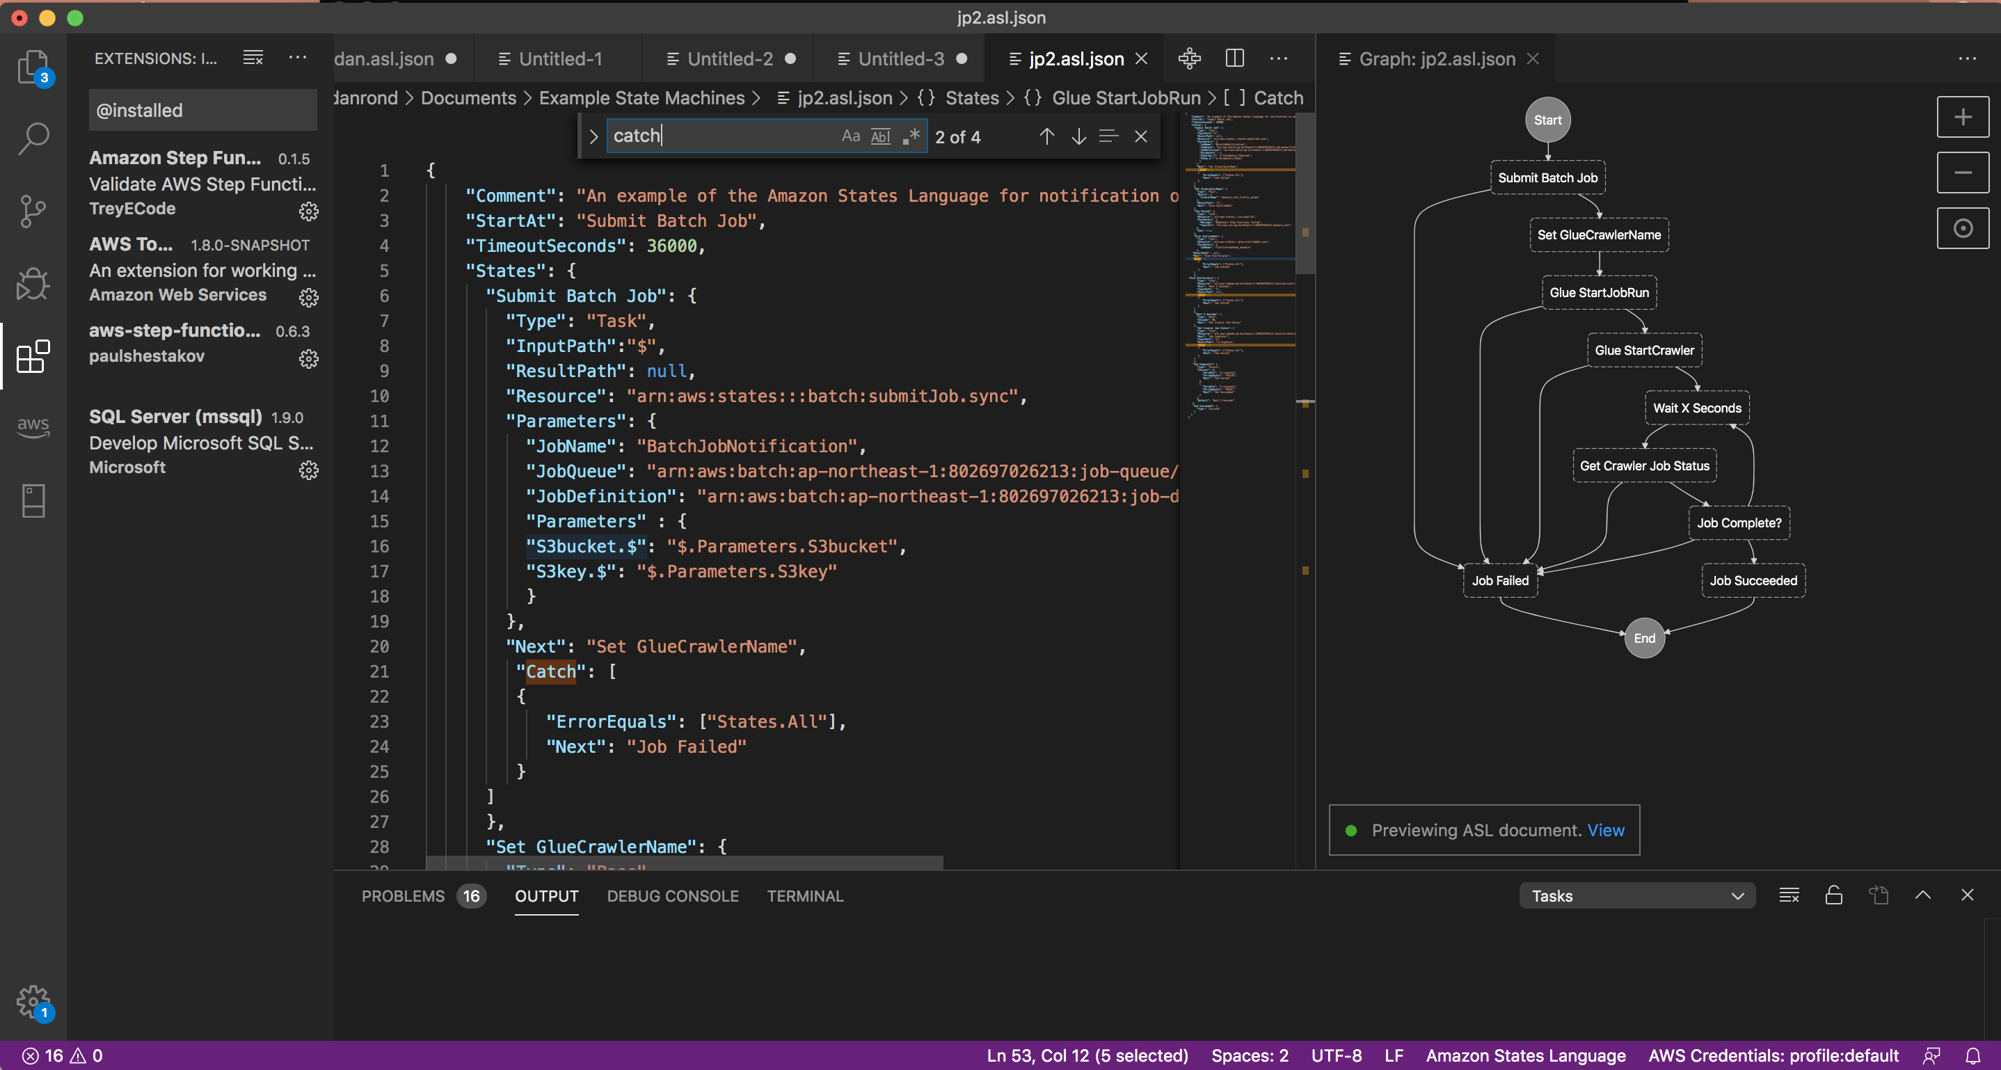
AWS Toolkit for VSCode
Local development platform
Build state machines locally
Workflow visualization
State machine linting
Code snippets and IntelliSense
Notes:
Github.com/awslabs/statelint
Docker aws-stepfunctions-local

Slide 78


Your Choice for Infrastructure as Code
AWS CloudFormation
DECLARATIVE
IMPERATIVE
Serverless Application Model
Declarative / template based
JSON / YAML
Cloud Development Kit
Imperative
Author state machines in TypeScript, JavaScript, Python, Java, C#
AWS Cloud Development Kit
AWS Serverless Application Model
Third-party IaC as Terraform are also supported (https://docs.aws.amazon.com/step-functions/latest/dg/terraform-sfn.html)
Notes:
Developer choice – support AWS SAM and AWS CDK

Slide 79
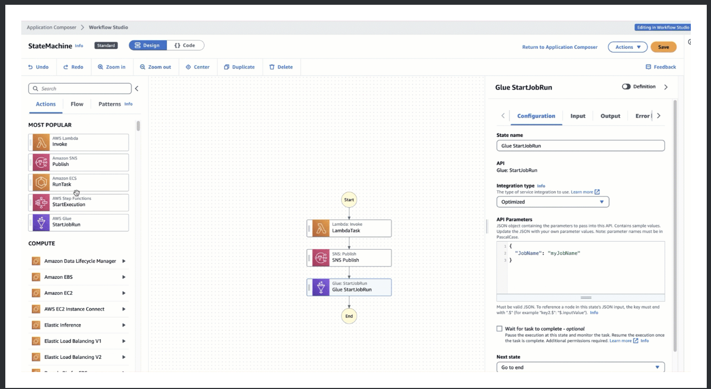
Using Workflow Studio in Application Composer (New)

Slide 80
Data Science SDK for Python
An open source library that allows data scientists to easily create workflows that process and publish machine learning models using SageMaker and Step Functions.
Provides a Python API that can create and invoke Step Functions workflows. You can manage and execute these workflows directly in Python, and in Jupyter notebooks.
https://github.com/aws/aws-step-functions-data-science-sdk-python

Slide 81
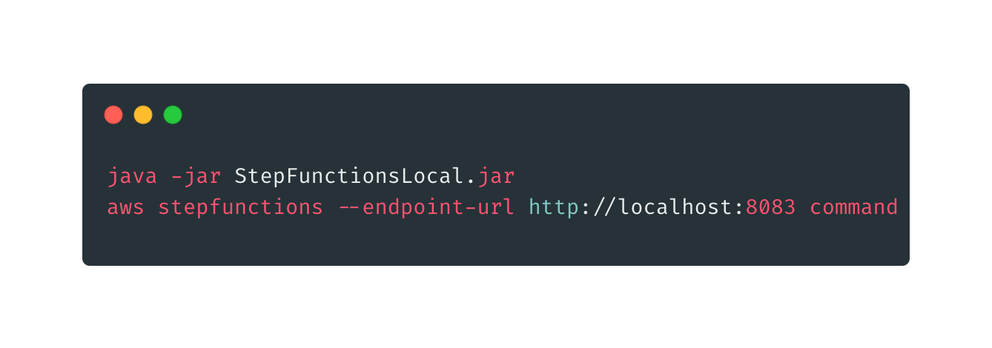
Step Functions Local
A downloadable version of Step Functions that lets you develop and test applications using a version of Step Functions running in your own development environment.
Available as a JAR package and as a Docker image.

Slide 82
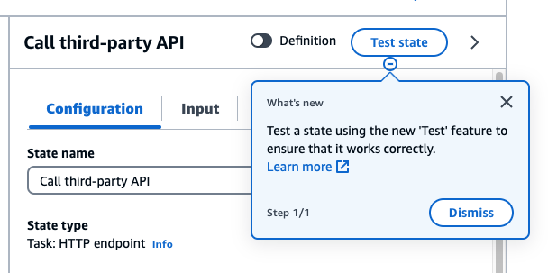
Test API (New)
The TestState API accepts the definition of a single state and executes it. Using the TestState API, you can test:
A state's input and output processing data flow.
An AWS service integration with other AWS services request and response
An HTTP Task request and response
Test can run for up to 5 mins. After that it times out
It does not support:
Activity Tasks
Service integration of the type .sync or .waitForTaskToken
Parallel or Map states

Slide 83
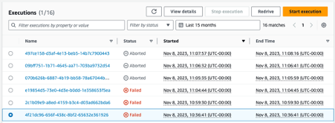

Redrive (New)
AWS Step Functions now allows you to easily restart workflows from their point of failure, so you can recover from failure faster, increase efficiency, and pay only for what you need.
Redrive works for Standard Workflows only.
You can redrive a workflow from its failed step programmatically, via the AWS CLI or AWS SDK, or using the Step Functions console

Slide 84



Versions and Aliases (New)
Using Step Functions Versions and Aliases you can maintain multiple versions of your workflows, track which version was used for each execution, and create aliases that route traffic between workflow versions.
You can deploy your workflows gradually using industry standard techniques such as blue-green and canary style deployments with fast rollbacks to your Step Functions workflows, increasing deployment safety and reducing downtime and risk.

Slide 85
Observability

Slide 86


Monitoring, Visibility, and Debug
Metrics
Executions, activities, service integrations, and more
Logs
Configurable for Standard Workflows
Express workflows emit by default
Tracing
Active Tracing
Configurable sampling rate
Amazon CloudWatch
Metrics
Amazon CloudWatch
Logs
AWS X-Ray
Notes:
Proper Serverless debug requires the Trifecta of Metrics, Logs and Tracing:
Step functions emits metrics for executions, activities, service integrations, and more [link]
Standard Workflows can be configured to emit to CloudWatch Logs with different logging levels. Express workflows emit by default [link]
Can both create and pass a trace. Configurable sampling rate.

Slide 87



Metrics
Helps to maintain the reliability, availability, and performance of workflows
Metrics such as Execution duration, success/failure rates, throttles, etc. are available out of the box
Metrics can be found under States Namespace in CloudWatch.
Dashboards can be created to provide summarized view of Executions
Additional details - Metrics
Notes:
Out of Box Metrics details
https://docs.aws.amazon.com/step-functions/latest/dg/procedure-cw-metrics.html#cloudwatch-step-functions-execution-metrics

Slide 88



Logs
Standard Workflows – Configurable
Express Workflows – Enabled by Default
Logs truncated at 248KB
Log levels can be set to OFF, ALL, ERROR or FATAL
Logs Insights can be used to aggregate and analyze data using CloudWatch Logs Insights query
Notes:
Tracing
Active Tracing – pass a previously generated trace or generate a new trace
Service Map View
Trace Map and Trace Timeline views
Use-Case
Profile your state machine executions
Analyze impact of outages
Optimize performance

Slide 89

AWS X-Ray
Tracing
Active Tracing
Service Map View
Trace Map and Trace Timeline views
Configurable sampling rate
Use-Case
Profile your state machine executions
Analyze impact of outages
Optimize performance
Notes:
Tracing
Active Tracing – pass a previously generated trace or generate a new trace
Service Map View
Trace Map and Trace Timeline views
Use-Case
Profile your state machine executions
Analyze impact of outages
Optimize performance

Slide 90



AWS Step Function - Console Debugging
Enhanced Execution Summary
Visual representation of the workflow execution
Events Display for the selected state, with their corresponding timestamp.

Slide 91

EventBridge events
You can configure EventBridge rules to react to events that are emitted when the execution status of a Step Functions state machine changes. This enables you to monitor your workflows without having to constantly poll using the DescribeExecution API.
Express Workflows do not emit events to EventBridge. Use CloudWatch Logs instead.
RUNNING
Amazon EventBridge
SUCCEEDED | FAILED | TIMED_OUT | ABORTED
Notes:
You can also schedule or trigger workflows with Amazon EventBridge

Slide 92
Best practices

Slide 93
Best practices
Use timeouts to avoid stuck executions
Use S3 when need to pass large payloads
Avoid reaching history quota
Handle Lambda service exceptions
Avoid latency when polling for activity tasks
Choose the right workflow type
Amazon CloudWatch Logs resource policy size restrictions

Slide 94
Cost Optimization Tips
Convert Standard workflows into Express workflows
Nesting Express workflows inside Standard workflows
Leverage Intrinsic Function (e.g. use the States.UUID() instead of Lambda functions)
Call AWS Services directly from Tasks (e.g. send a message to Amazon SQS or Insert or get an item from Amazon DynamoDB)

Slide 95
Next Steps

Slide 96


https://catalog.workshops.aws/stepfunctions

